Slide 1
Quiz Management
System
Muzammil Siddiq Jethwa B19102111
Muhammed Ahmed Amir B19102063

Slide 2
OverView
Let’s find out from where we
have Started!

Slide 3

Idea
So, In our bachelor’s in Computer Science we were studying OOP in Java Programming.
We got our task as a Semester Project to be done in a month and also select a system by our self.
After researching some contents we decided to make a “Quiz Management System” as a clone of ‘Socrative Web Application’.

Slide 4
Prerequisites
What Steps we
followed to make this Application

Slide 5

Programming Language
Java
Java is a high-level, class-based, object-oriented programming language
As we said above we were studying concepts of OOP in JAVA.
So there was no choice

Slide 6
Jar Files(Libraries)
JSoup
Json-simple
Jsoup is an open-source Java library designed to parse, extract, and manipulate data stored in HTML documents
We used Jsoup for Extracting data(MCQs) from different sites and stored it
JSON.simple is a simple Java toolkit for JSON. You can use JSON.simple to encode or decode JSON text
or
simply we can say that we use this for parsing JSON Files

Slide 7
Jar Files(Libraries)
Gson
Gson is an open-source Java library(by Google) to serialize and deserialize Java objects to JSON
or
simply we can say that we use this for Formatting data in JSON Files

Slide 8
File Handling
(Storing Data)
JSON
JSON is an open standard file format and data interchange format that uses human-readable text to store and transmit data objects consisting of attribute–value pairs and arrays.
We used JSON for Creating, Storing, Updating and Deleting data used in our whole Project.
It’s like a simple offline database on your hard drive.

Slide 9
User Interface
Swing
JFrame
Swing is a GUI widget toolkit for Java
We used Swing as our tool to make User Interface(UI) in our whole Project
JFrame works like the main window where components like labels, buttons, text-fields are added to create a GUI.
It’s like a drag and drop UI components

Slide 10

IDE
NetBeans
We have selected Netbeans for programming in java
NetBeans is an integrated development environment for Java.

Slide 11
Structure
What file structure
we made to run this application perfectly

Slide 12
User Interface
For User Interface we made more than 15 classes(panels) with JFrame along with their backend on the same file using different methods that reads data from where we saved it or updated during runtime.
It’s starts from
Quizproject > src > quizproject > loading.java
file and ends on according to the hierarchy you follow.

Slide 13
JSON Files
We used 3 different JSON files to save three types of data.
TeachersData.json to save teacher’s data.
QuizScore.json to save whole student data.
Final_Quiz.json to save Quiz data.

Slide 14
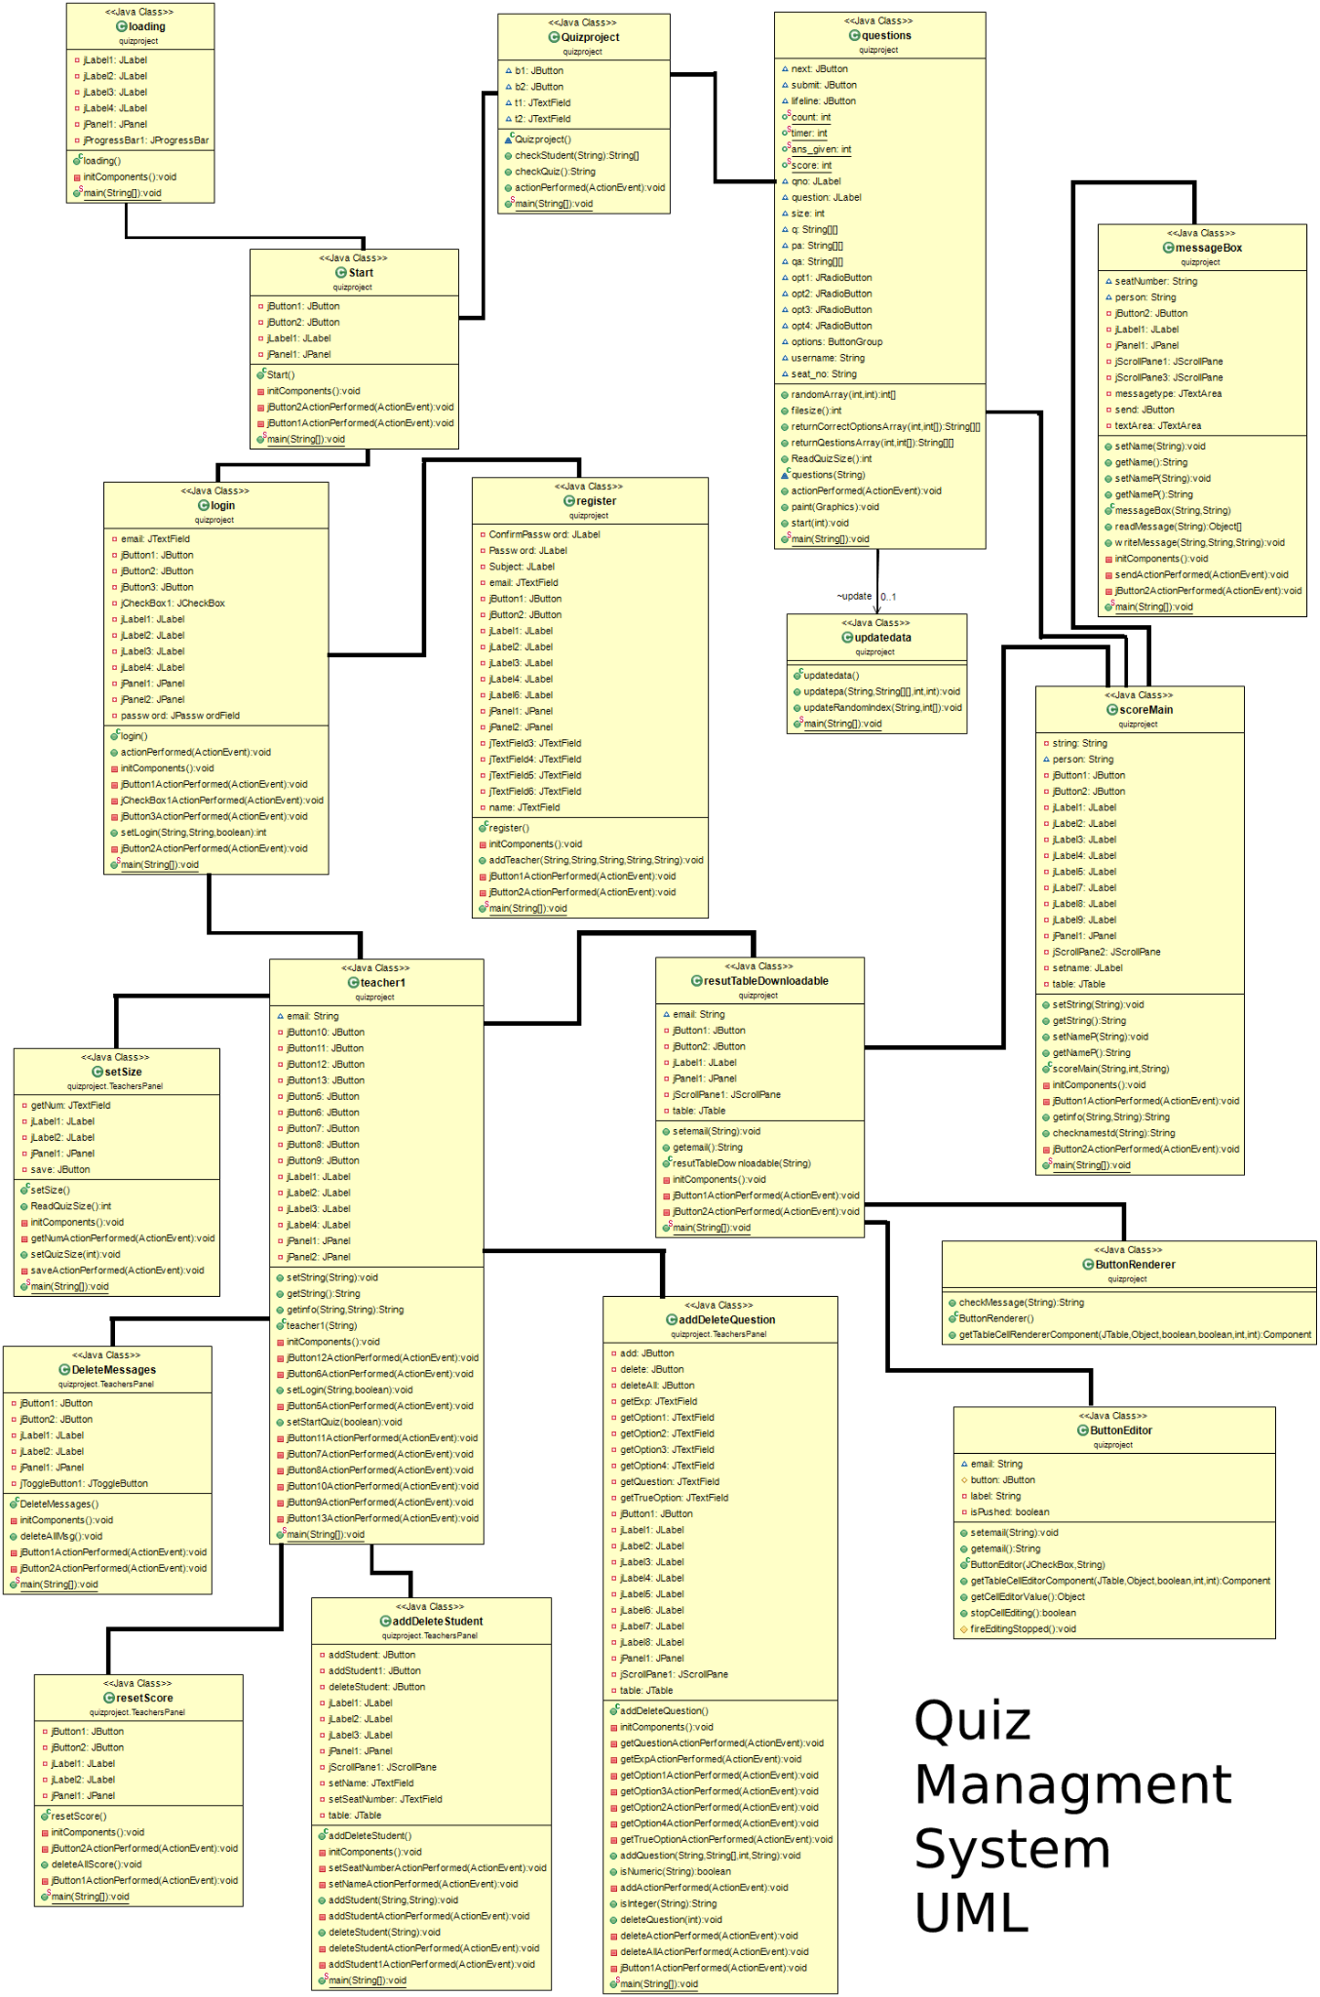
UML
So, this is our UML, the lines shows the flow of data between these classes.
It’s very big enough to display here properly but you can find this image in our repository named as
“QuizUml.png”.

Slide 15
Description
Key points of our Project

Slide 16
Overall Review
In this project a teacher may register and login to it’s personal panel where he starts a Quiz and logout.
After that students may join the Quiz by entering their seat number, the Questions will be selected randomly and student will have to give that Quiz. Each Question will have 15 seconds to give answer. At last they will see their Detail Score Sheet.
After that, that teacher have to login again to end the Quiz according to his time.
Then he can see and download the Result in ‘.csv’ file and clear the stored records of the students.
Note: Each teacher can take Quiz one at a time

Slide 17
Teacher’s Perspective
A Teacher Can
Register
Login
Add or delete any student
Change Quiz Questions
Delete Messages
Set Quiz size
Watch any student’s Score Sheet
Send Message to any Student Privately
Download Result
Delete score of students
Start or End Quiz
Logout

Slide 18
Student’s Perspective
A Student Can
Join to Quiz
Give Quiz
Ignore any question
Submit Quiz
Send Message to Teacher Privately
See it’s Score Sheet anytime after submitting the Quiz

Slide 19
Presentation
Let’s begin our Socrative Clone!

Slide 20
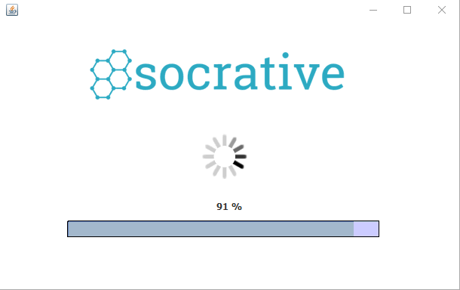
1) Loading Screen
First, the project is showing you the loading screen,
after the loading will be 100% completed then it will di-visible and it will show you the next slide.

Slide 21
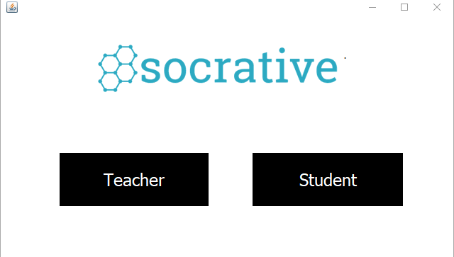
2) Home Screen
After the loading screen this screen will show, two buttons are design on this screen to show you the details of the student and teacher.

Slide 22
Presentation
Teacher’s Prespective

Slide 23
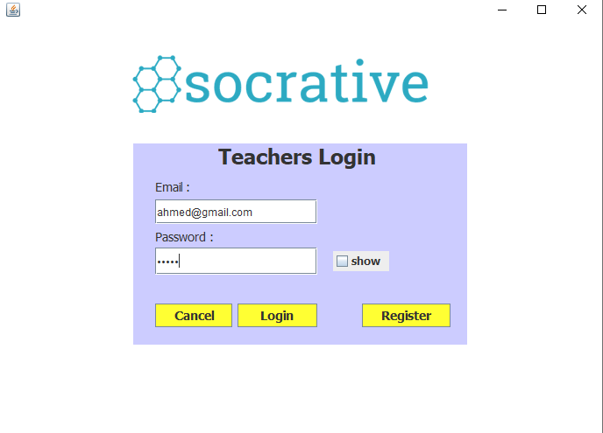
3) Teacher’s login
If you click on the teacher's button then this screen will show, and ask the email and password of the teacher for the login.

Slide 24
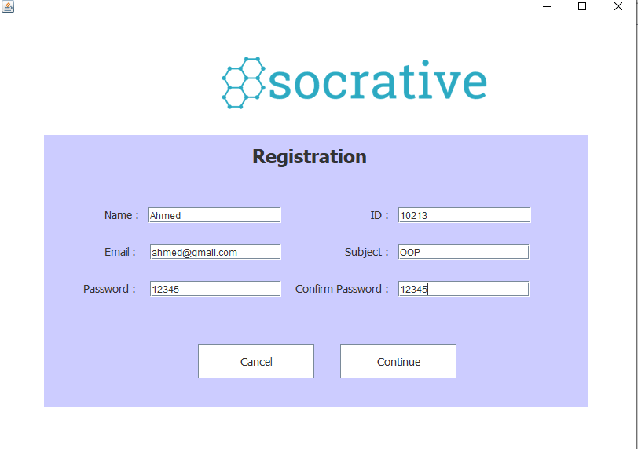
4) Teacher’s register
Before login, first you need to register yourself and fill out all the information in the registration form.

Slide 25
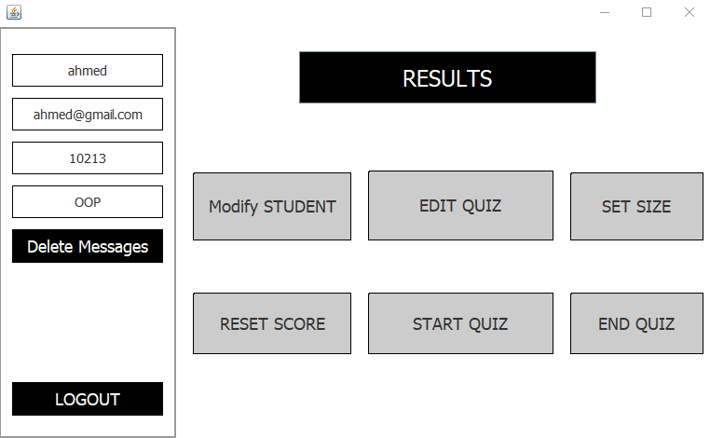
5) Teacher’s home page
after login this screen will open,
at right of this screen there are seven buttons for the teacher to modify and check the details of a quiz and the students.

Slide 26
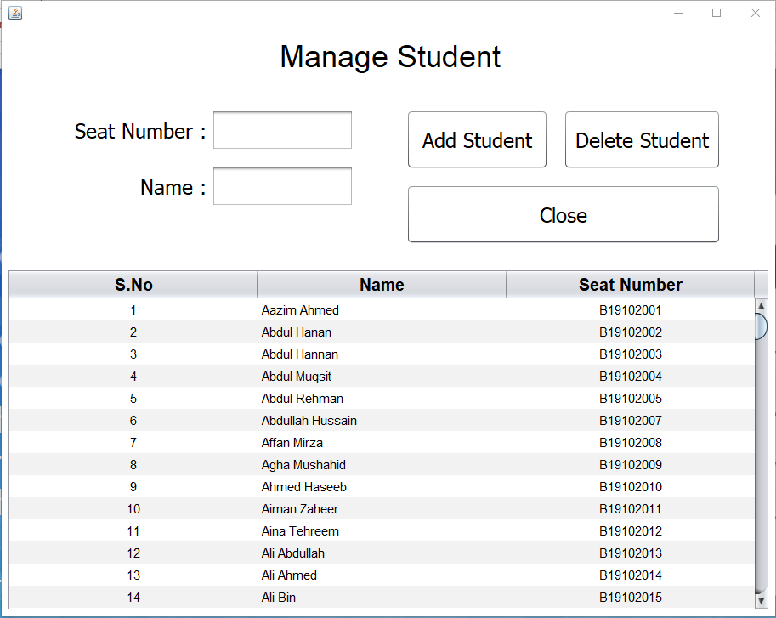
6) Modify Student
If you click on the modify student,
this screen will open to add or delete student by providing the name and seat number.

Slide 27
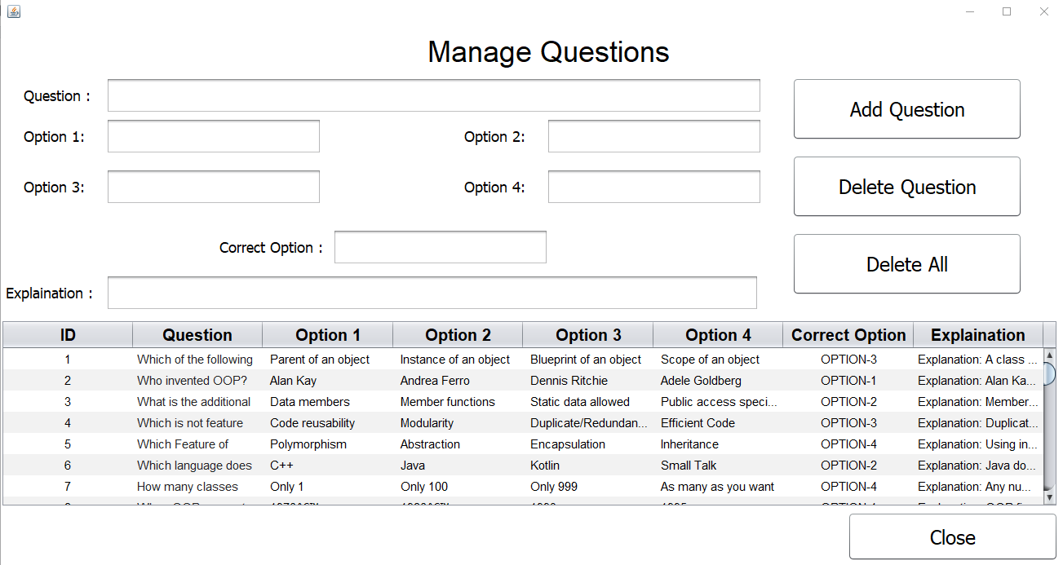
7) Edit Quiz
If you click on the Edit Quiz,
this screen will open to add or delete question by providing the detail of the question.

Slide 28
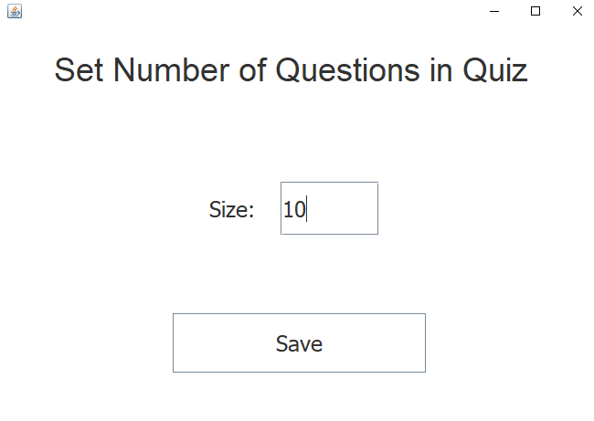
8) Set Size
If you click on the set size,
this screen will open to set the number of questions that will randomly selected from the Question’s file when the student will join the Quiz.

Slide 29
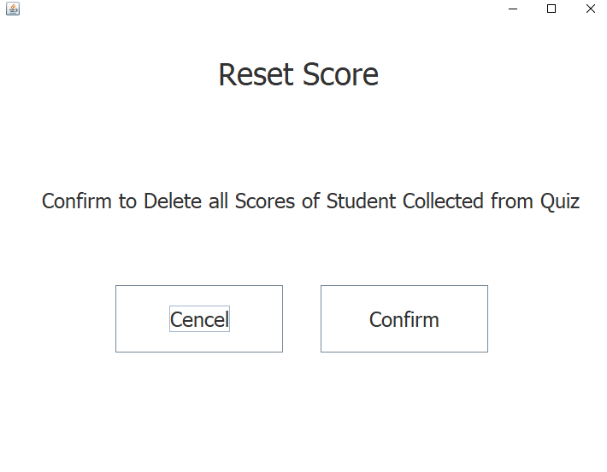
9) Reset score
If you click on the reset score,
this screen will open to delete the score of all student.

Slide 30
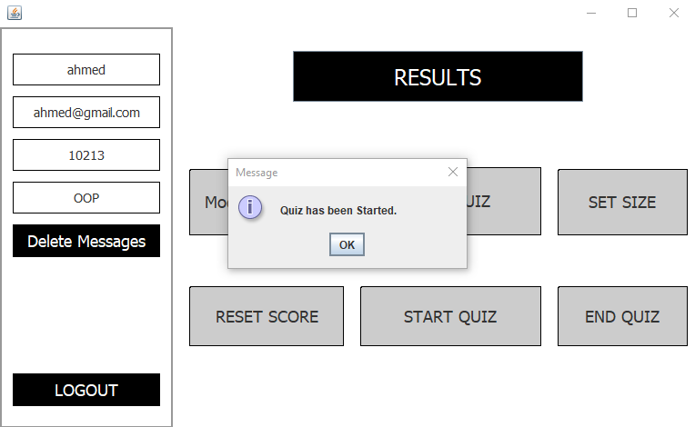
10) Start Quiz
by clicking on the start quiz button, this message will show and now the student is able to give the quiz by providing the correct seat number.

Slide 31

11) End Quiz
by clicking on the End quiz button this message will show, and now the student is not able to give the quiz until the teacher will starting the quiz again.

Slide 32
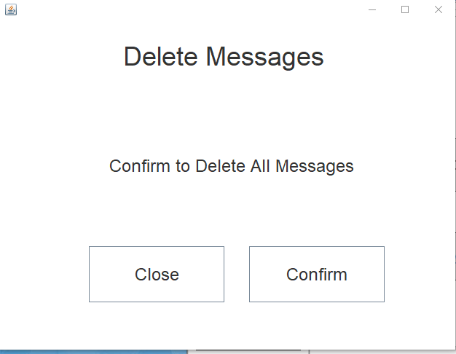
12) Delete Messages
A Teacher can delete all chat history of Students by clicking on the Confirm Button in Delete Messages.

Slide 33
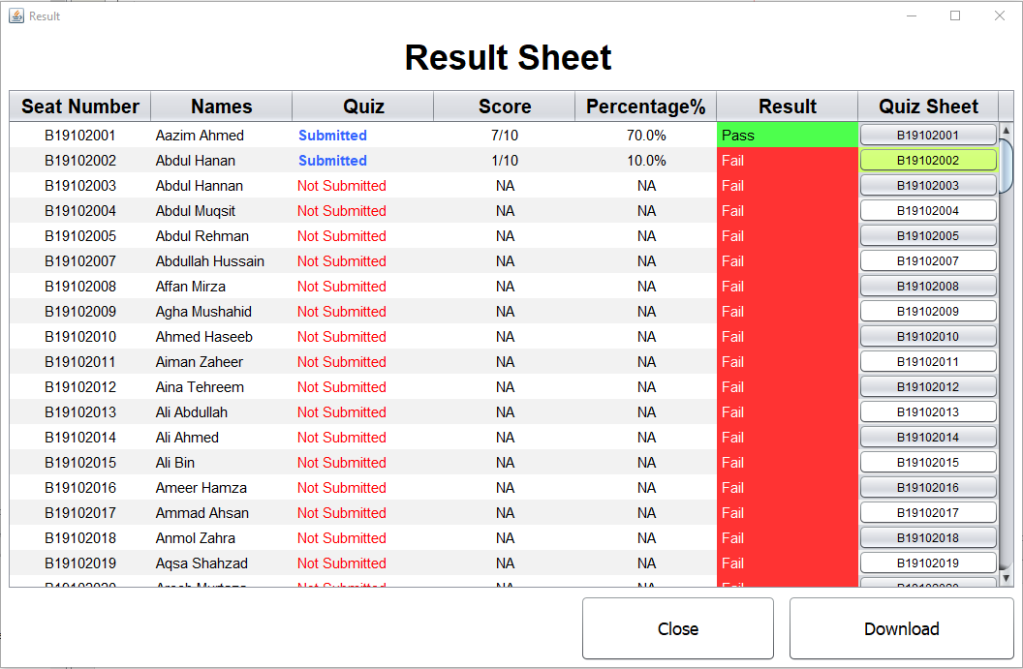
13) Results
by clicking on the results button this screen will open, to check the result of all the students.
Here, the highlighted button means Student have send a private message to Teacher.

Slide 34
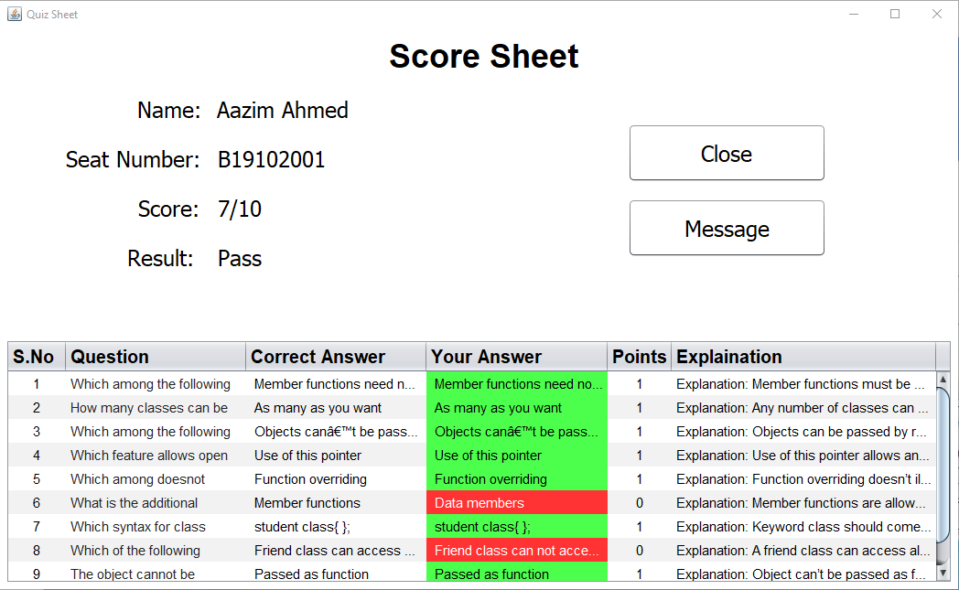
14) Quiz Sheet Button
On the above panel you can see a button on Quiz Sheet row with Seat Number of Students.
If we click those, so that will display the Score Sheet of each of the Students who have given the test and Teacher can also send that Student a message through message button.

Slide 35
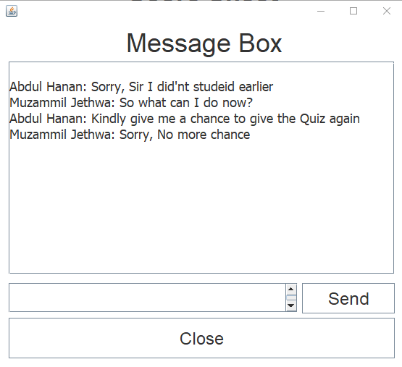
15) Message Box
While on clicking on Message Button in Score Sheet, this window will appear where Student and Teacher both can co-ordinate to each other privately

Slide 36
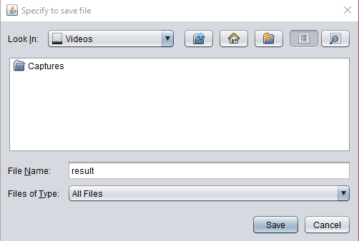
16) Download Button
by clicking on the Download button on Result a new panel will appear that will save the overall table data into .csv(Excel) format.

Slide 37
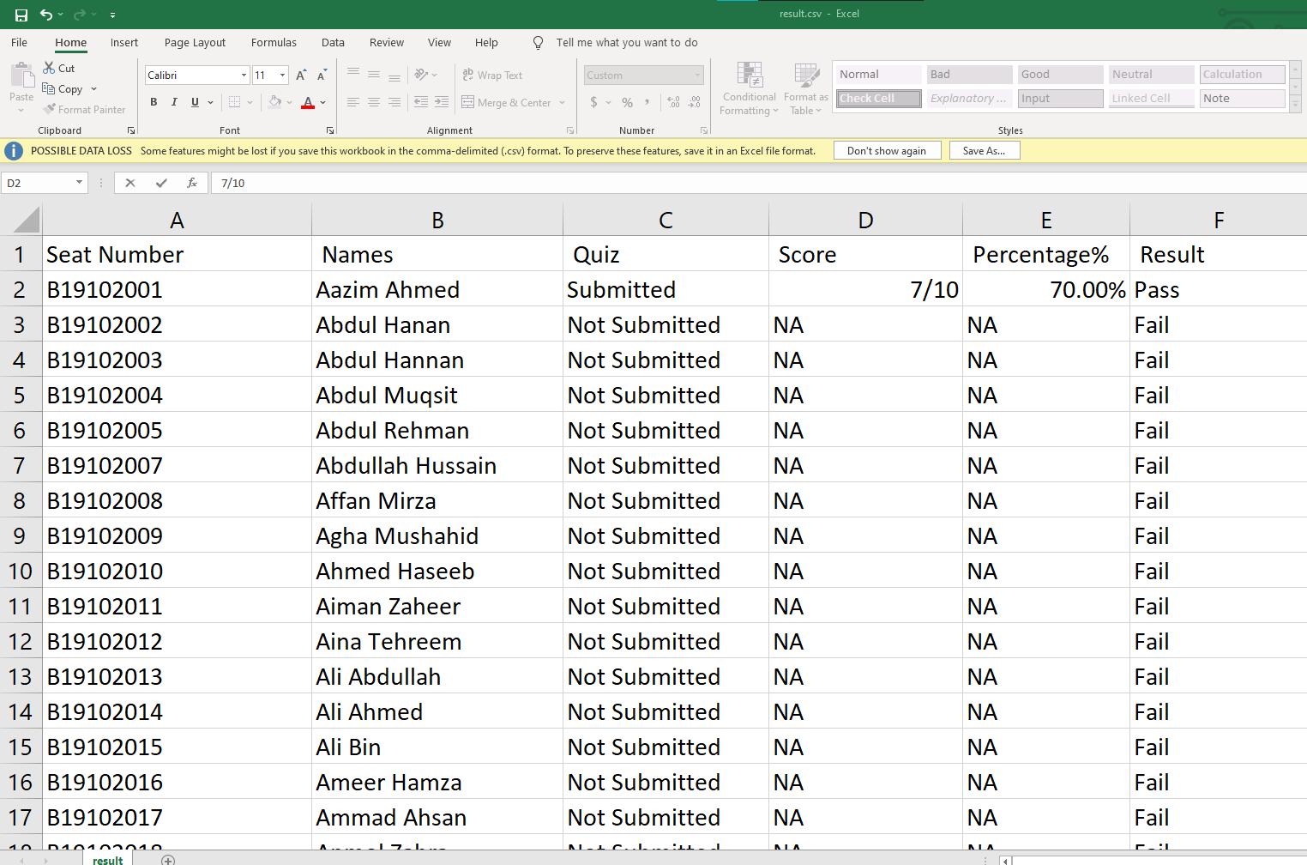
Result in Excel
Then the csv file will save to the destination you want and after opening the file, it will look like this

Slide 38
Presentation
Student’s Prespective

Slide 39
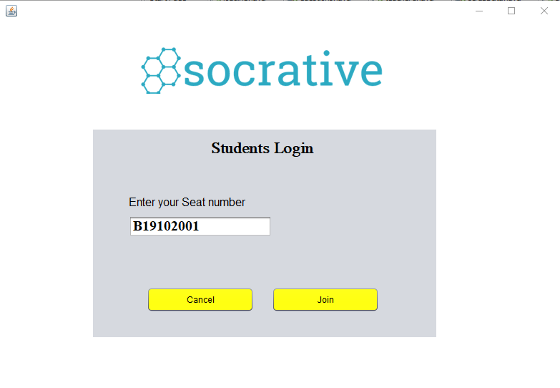
17) Student’s login
When you click on the student button in the home page, this screen will open, and ask the seat number of the student for joining the quiz.

Slide 40
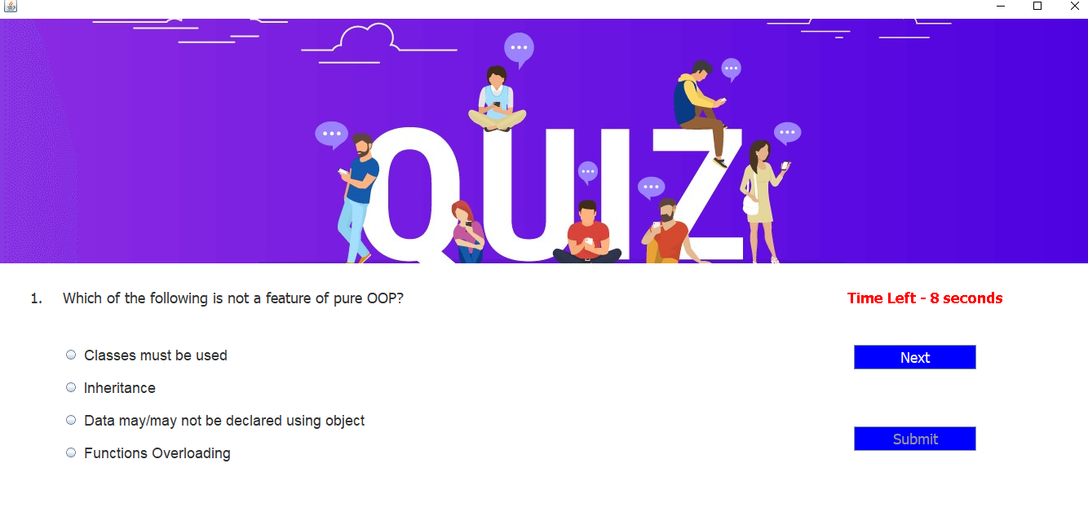
18) Quiz screen
After click on the join button, this screen will open for giving the quiz.

Slide 41
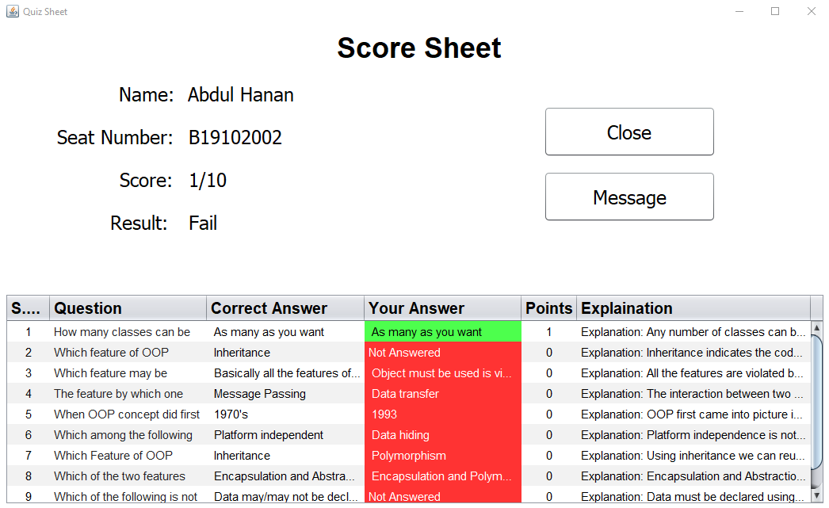
19) Score screen
After submitting the quiz, this screen will open, to display the student's score and answer sheet with the functionality to contact Teacher through message.

Slide 42
Future Plans
What modifications we
can do in this project in future

Slide 43
Online Data
Multiple Teachers
As we all know JSON is now the most used database format in Web and Online industry.
We can set our Json files online and link that files to our project, so that our data will be access to anyone on any place from our Application.
If we do some minor modifications in our backend and Json files then our Application can be able to take Multiple Quiz from Multiple Teachers at a time.

Slide 44
Separate
Message Box
Proper Application
We can add a Message Box between multiple teachers and multiple students to communicate with each other with more privacy and have the option to delete their own Messages.
If we will able to do the above mentioned modifications to our Application with perfection and with proper documentation then our Application will be able to Release in market and can be able to be used by a proper Schooling System.

Slide 45
Source Code
From Where you
can find our Source Code?

Slide 46

GitHub
We have uploaded our Project on GitHub and
Now our Project has become Open Source so, you can find our source code from our GitHub Repository
Repo Link:
https://github.com/Muzammiljethwa/OOP-in-Java/tree/master/Quizproject

Slide 47


Contributions
We are willing have Open Contributions in our Project to make it more efficient and to achieve the goals described above in ‘Future Plans’
Just download Git and run the below given command to clone the repository
git clone https://github.com/Muzammiljethwa/OOP-in-Java.git
We are awaiting for your Contributions

Slide 48


Main Contributions
Our Main Contributors are:
Name: Muzammil Jethwa
Seat Number: B19102111
GitHub: https://github.com/Muzammiljethwa/
Name: Muhammad Ahmed Amir
Seat Number: B19102063
GitHub: https://github.com/AhmedAmir1/

Slide 49
Any Question?
Ask us anything
about the whole Project

Slide 50
References
From where we
got help when we stuck

Slide 51




References
We got help from multiple sites, like
Stack Overflow
Youtube
Google
Java2s
Tabnine
Sanfoundry, etc.
some links are provided
in ‘mainLinks.txt’ file

Slide 52
ThankYou!

